Slide 1






Trends in technology
By Lucia Petillo
Capstone Project
April 2023

Slide 2




OUTLINE
Executive Summary
Introduction
Methodology
Results
Visualization – Charts
Dashboard
Discussion
Findings & Implications
Conclusion
Appendix

Slide 3

EXECUTIVE SUMMARY
A 2019 Stack Overflow survey was analyzed for the current and predicted future trends in technology
JavaScript, HTML/CSS, and Python are both the current and trending programming languages in the future.
In 2019 the top 5 Database Management Systems (DBMS) were all SQL databases, with the exception of MongoDB in 5th place. However, next year non-relational NoSQL databases are expected to become much more popular, with MongoDB jumping to 2nd most popular overall and two more non-relational DBMS making the Top 5 databases list. This may be because there is a growing demand for databases that can handle increasingly complex and varied data in an unstructured or object-oriented format.
The most popular languages to learn are JavaScript, HTML/CSS, and Python, but the highest paying languages to learn are Swift, Python, and C++

Slide 4

INTRODUCTION
This presentation will analyze and present the findings of data drawn from a 2019 Stack Overflow survey. Stack Overflow is a popular programming forum for developers. A subset of cleaned and normalized data was used.
Many different questions were asked in the survey, but in this presentation, we will be focusing on the most popular programming languages and databases in order to predict future trends.

Slide 5

METHODOLOGY
Data was extracted from the results of a 2019 Stack Overflow survey. A random subset of 10% the data was used due to the size of the survey data. (This data was preselected as part of the course.)
The data was cleaned, normalized, explored and analyzed using Python.
The most important trends and takeaways were transformed into a dashboard visualization using IBM Cognos.
A second dataset was used to generate the two graphs in the appendix: programming languages vs salary and job postings per location. This dataset was gathered using web scraping with Python APIs.

Slide 6
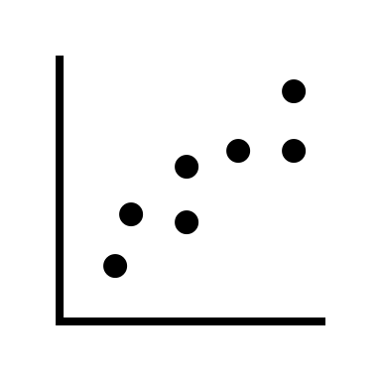
RESULTS

Slide 7
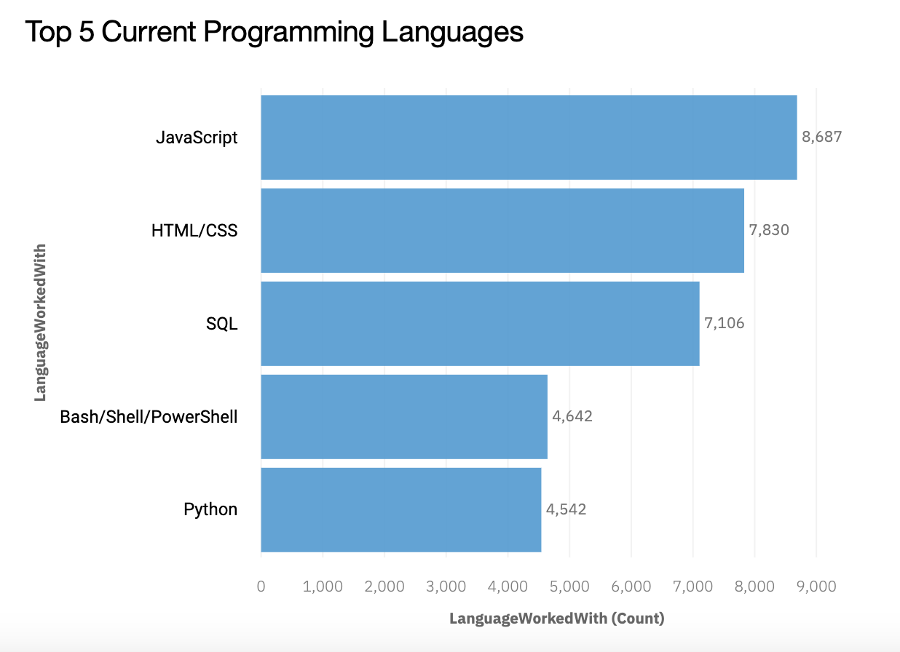
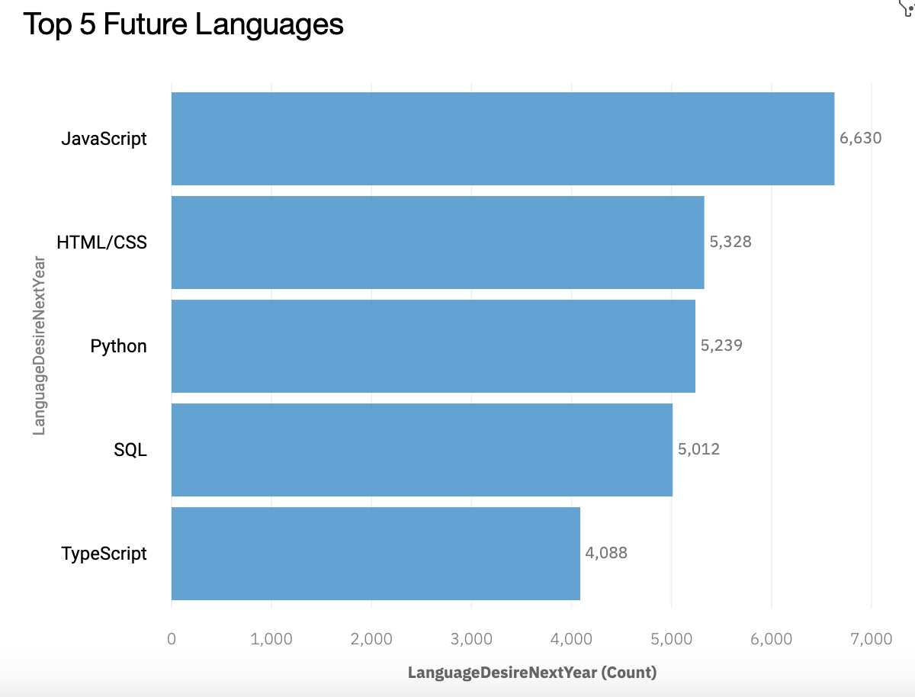
PROGRAMMING LANGUAGE TRENDS
Current Year
Next Year

Slide 8
PROGRAMMING LANGUAGE TRENDS - FINDINGS & IMPLICATIONS
Finding #1
JavaScript and HTML/CSS are in the top two for both current and trending programming languages
Implications
Web developers are their associated programming languages (Javascript, HTML, and CSS) are currently the most popular. This matches the other data in the survey that indicates that “full stack web developer” was the most frequently selected developer type. Furthermore, these programming languages are expected to remain in high demand next year.

Slide 9
PROGRAMMING LANGUAGE TRENDS - FINDINGS & IMPLICATIONS
Finding #2
Python and SQL are both popular now and will continue to make the top 5 next year
Implications
SQL is the most popular programming language for working with databases. Despite the growth of NoSQL databases, the demand for SQL skills will remain for at least another year. Python moved up in the rankings slightly as it continues its trajectory to become the most popular programming language, due to it’s easy to learn syntax, extensive libraries and wide range of applications. Python is used in both backend web development and data analysis, which could be fueling its rise as demand for these jobs remains high.

Slide 10
PROGRAMMING LANGUAGE TRENDS - FINDINGS & IMPLICATIONS
Finding #3
Bash/Shell/PowerShell is currently ranked the 4th most popular language, but by next year is predicted to be only the 7th most popular, dropping out of the top 5 chart.
TypeScript will rise from the 8th most popular language for this year to the 5th most popular language for next year.
Implications
TypeScript is a language for application-scale JavaScript. TypeScript beating out Bash indicates the demand for large-scale JavaScript applications and web development will become even stronger next year. Bash is used to automate systems and tasks, and it could be that other more user-friendly tools may slowly take its place.

Slide 11
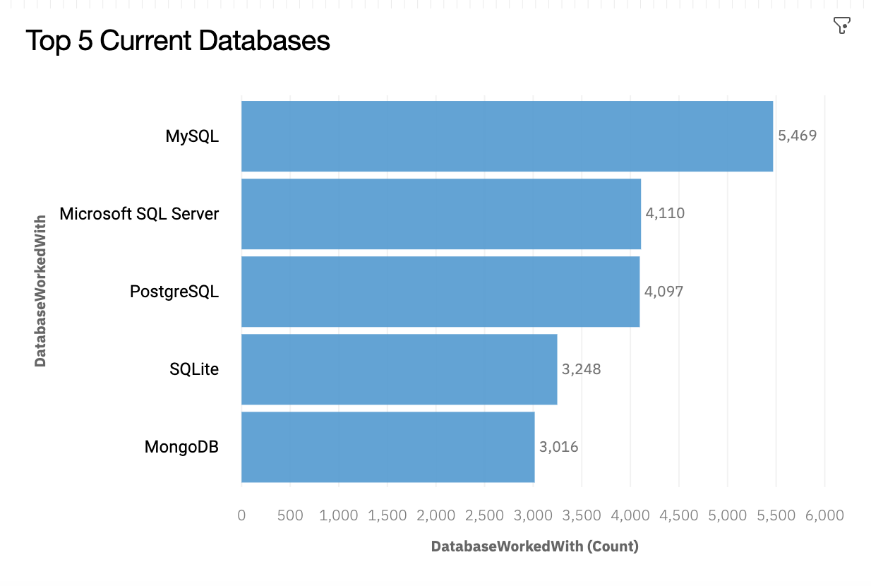
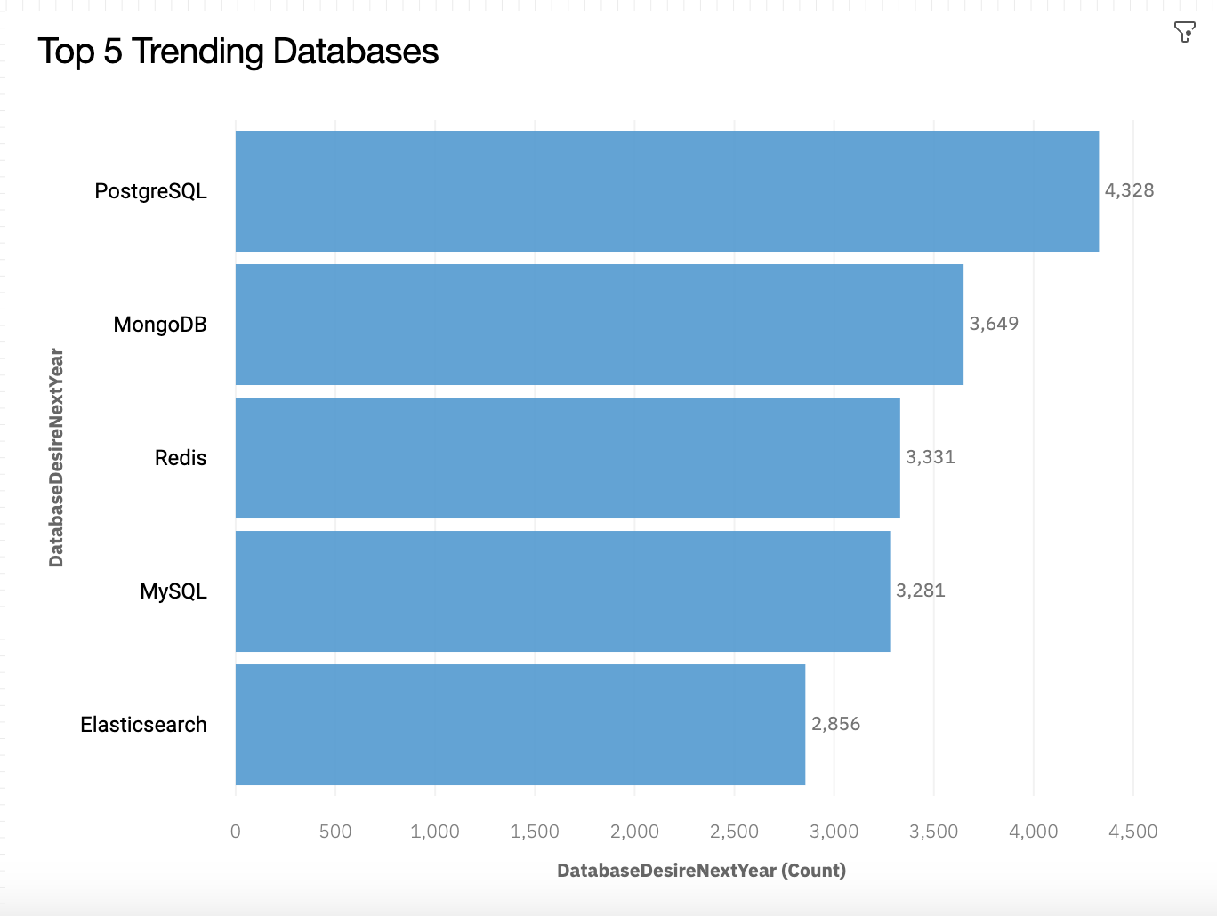
DATABASE TRENDS
Current Year
Next Year

Slide 12
DATABASE TRENDS - FINDINGS & IMPLICATIONS
Finding #1
SQL has dropped from #1 to #4, while PostgreSQL has climbed from #3 to #1.
Implications
While MySQL is a pure relational database, PostgreSQL is an object-oriented database that can handle more complex forms of data. This may reflect the business need to deal with increasingly complex data, as well as the benefits of an object-oriented database.

Slide 13
DATABASE TRENDS - FINDINGS & IMPLICATIONS
Finding #2
Microsoft SQL Server is projected to go from being the second most popular to the sixth most popular next year. SQLite is also projected to drop out of the top 5 to 7th place next year. They are being replaced by Elasticsearch and Redis who will become more popular next year.
Implications
There may be an increased demand for databases to deal with increasingly complex and varied forms of data. Thus, noSQL databases like Elasticsearch and Redis are projected to become more popular than traditional SQL databases, due to their superior ability to store abstract and complex data types in a more flexible way.

Slide 14
DATABASE TRENDS - FINDINGS & IMPLICATIONS
Finding #3
MongoDB is predicted to rise from the 5th most popular to the 2nd most popular database management system.
Implications
MongoDB is another non-relational DBMS that does not use SQL, and follows the trend of other non-relational databases, like Elasticsearch Redis, becoming more popular over traditional relational databases due to their increased flexibility. MongoDB is currently the most popular non-relational database and is projected to remain so.

Slide 15

DASHBOARD
IBM Cognos Dashboard permalink:
https://dataplatform.cloud.ibm.com/dashboards/957ac389-9dde-4b94-8dd4-2fc921284cf7/view/4f1fe30e38b023e95ee8cce407cb7a0329662d5fe6bbd506818c7b495d327497a9381599c82d1e588c425662faba175fc1
See the full interactive version of the dashboard and graphs used for this presentation.

Slide 16
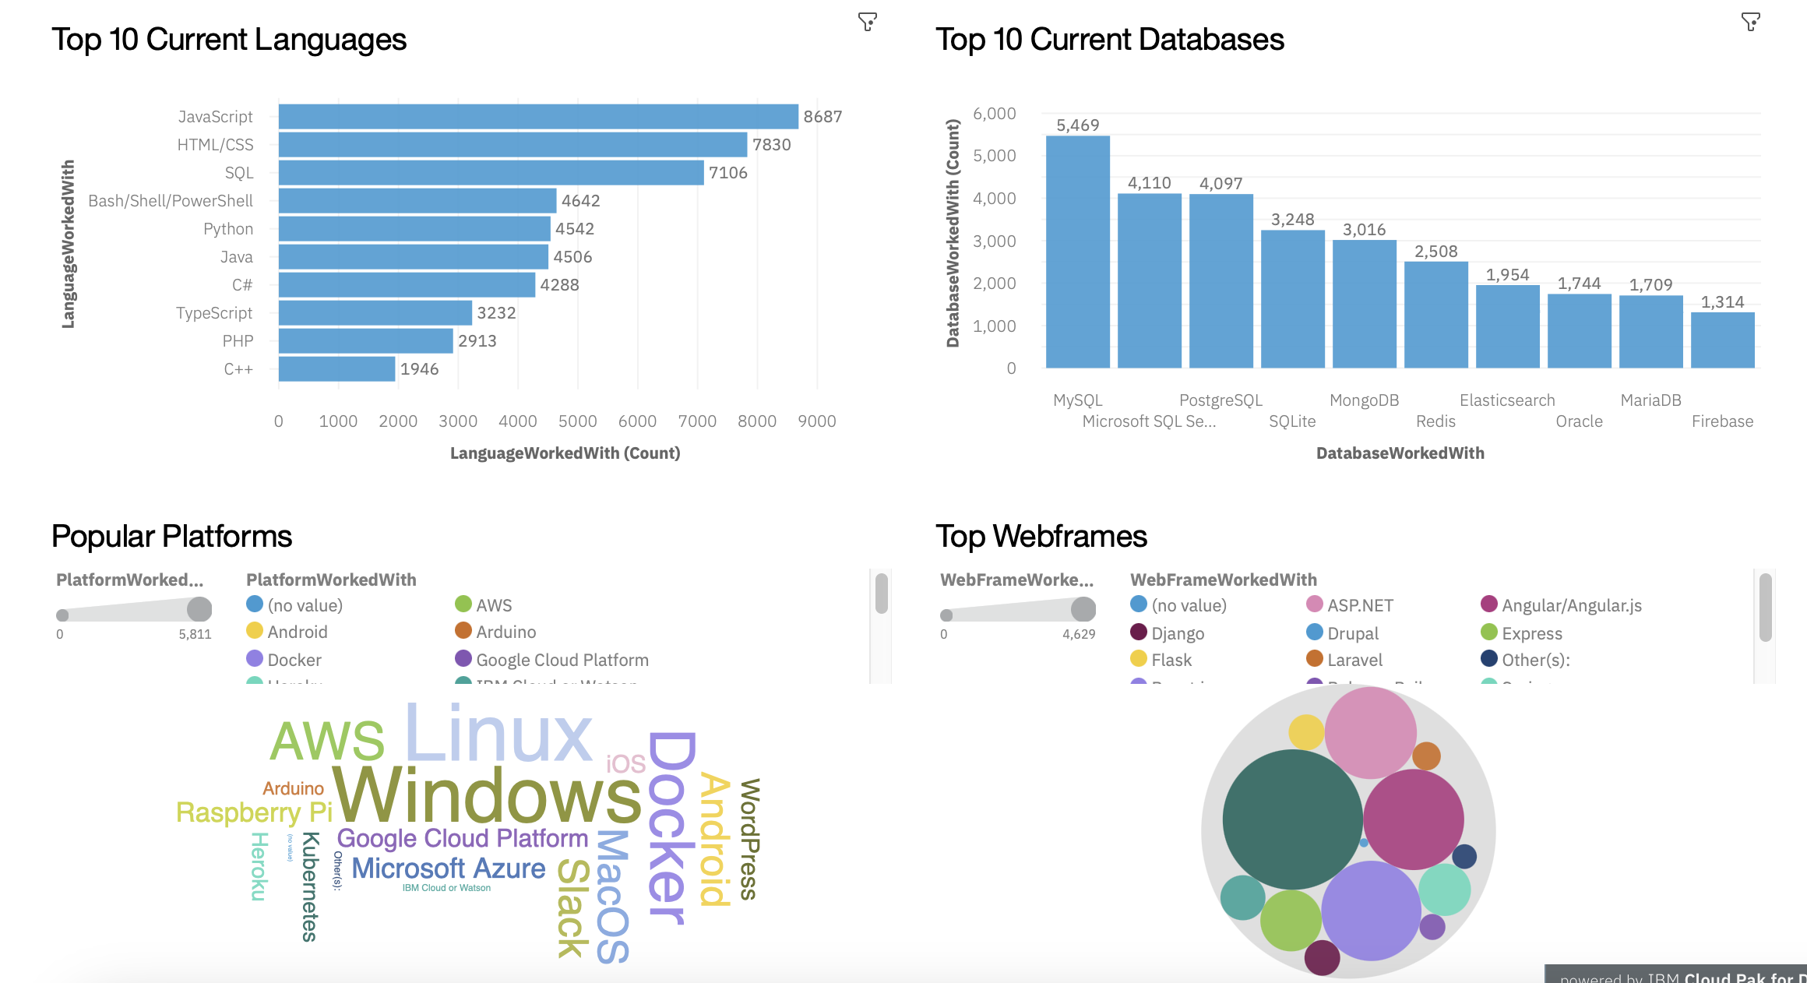
DASHBOARD-CURRENT TECHNOLOGY OVERVIEW

Slide 17
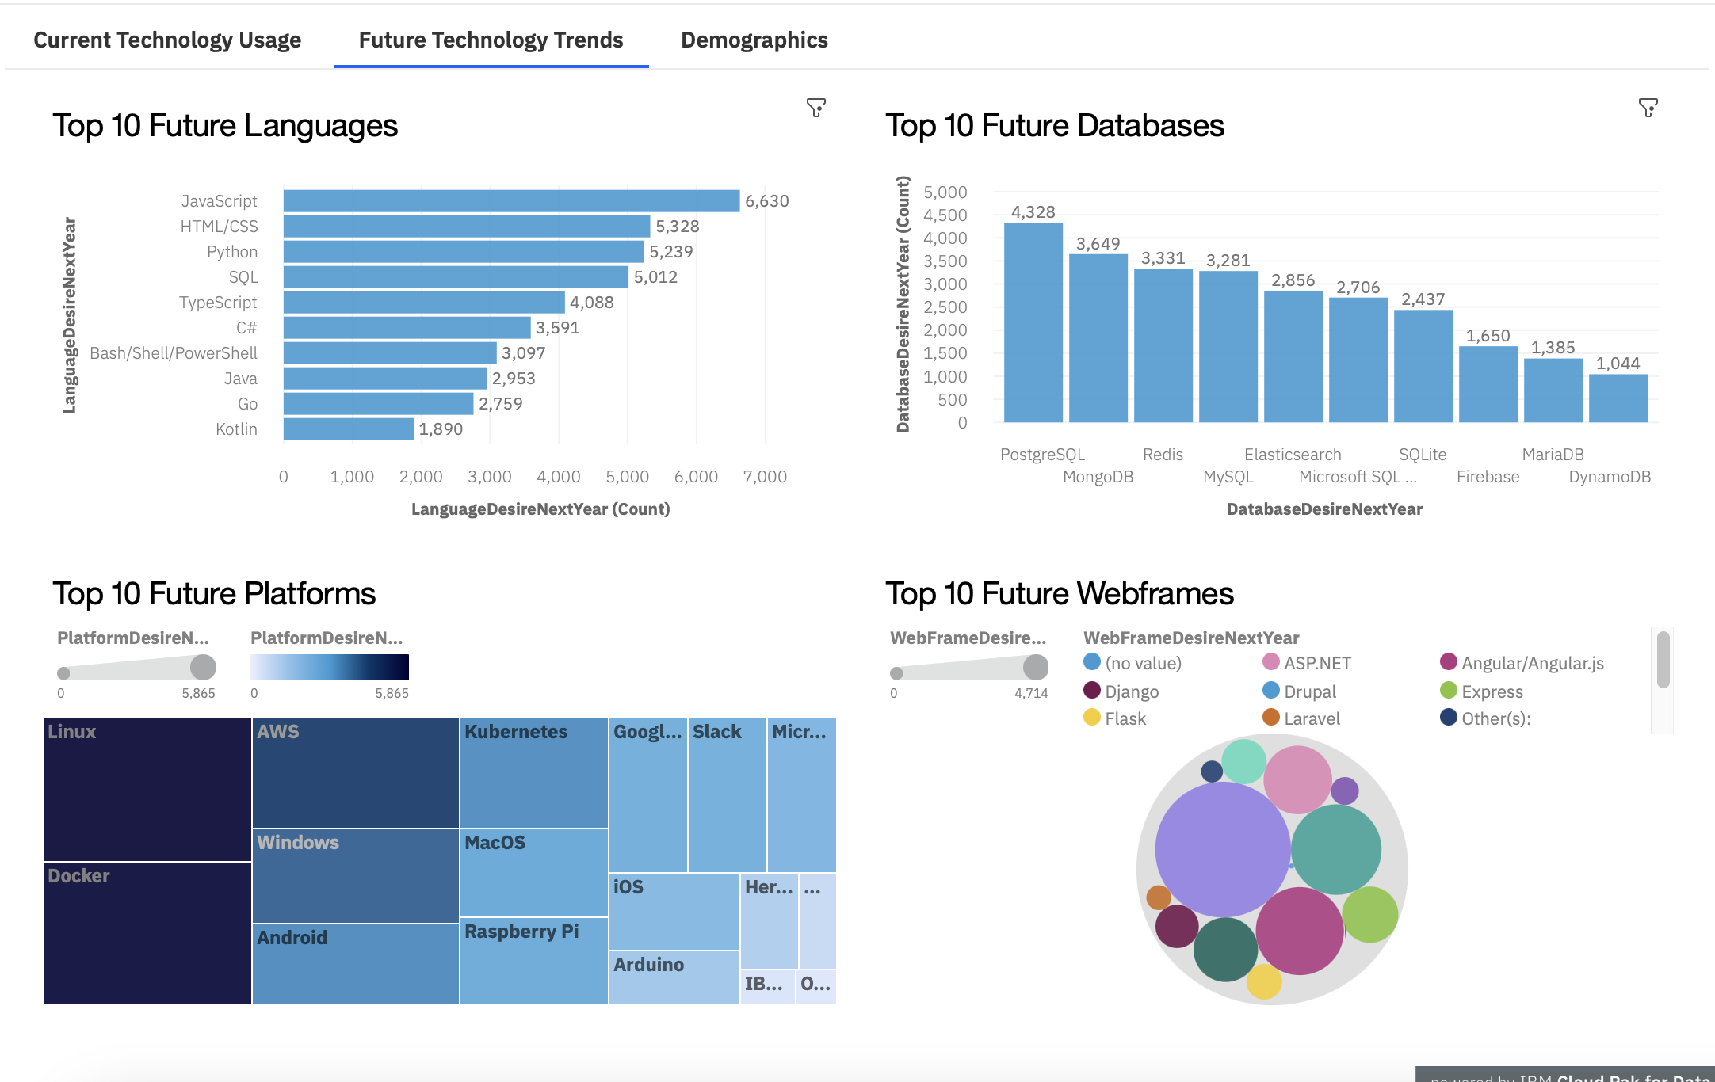
DASHBOARD-FUTURE TECHNOLOGY TRENDS

Slide 18
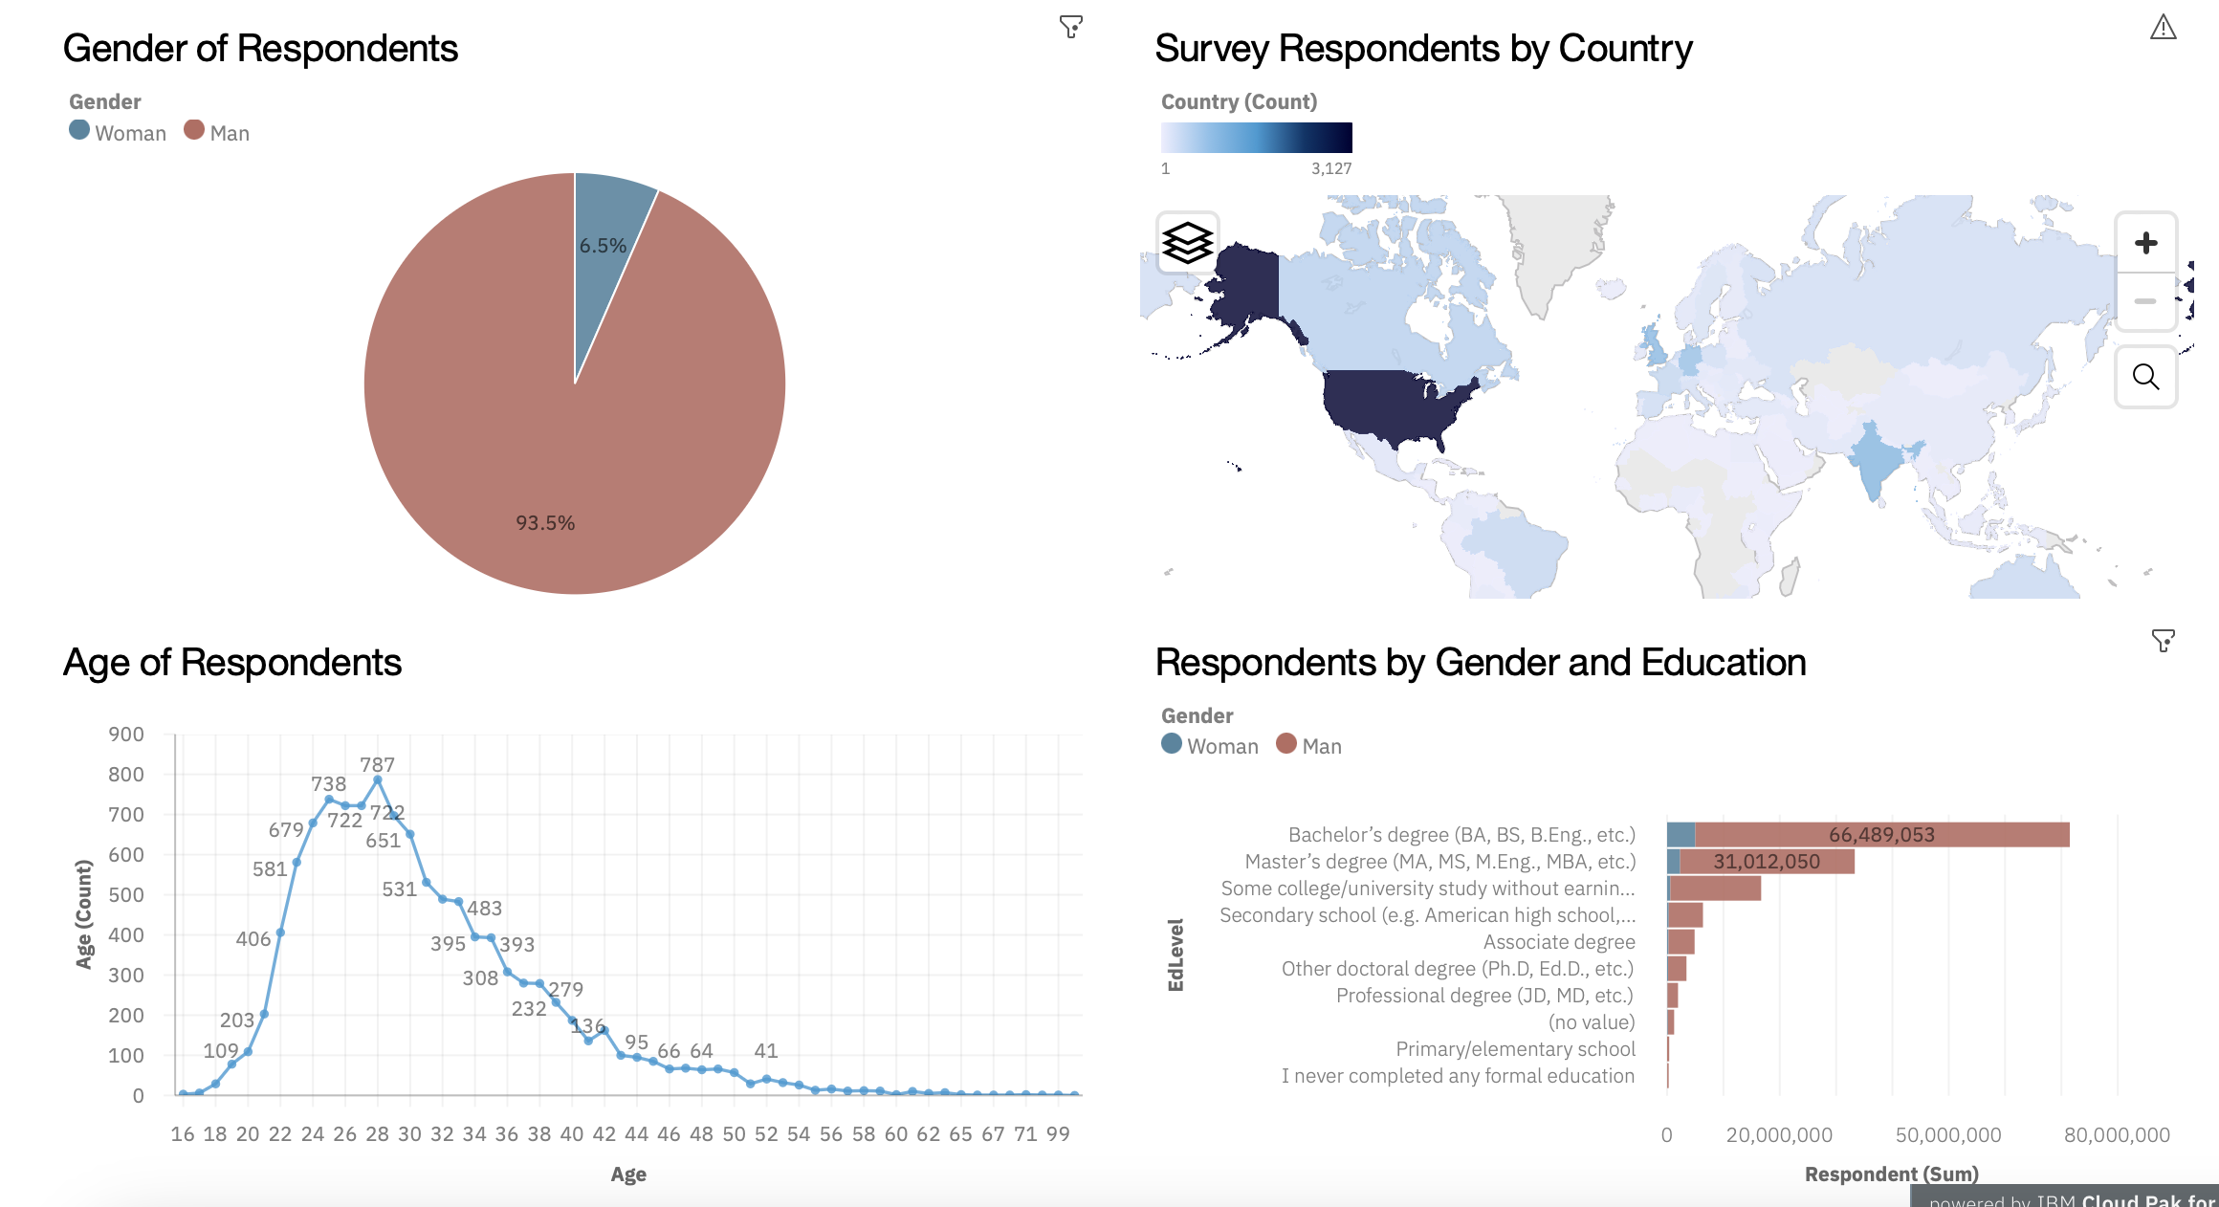
DASHBOARD-DEMOGRAPHICS OVERVIEW

Slide 19

OVERALL FINDINGS & IMPLICATIONS
Finding #1
Relational SQL databases are projected to become less popular across the board, and will be replaced by more flexible non-relational databases.
Implications
There is a greater demand for flexible databases that can handle unstructured, complex or varied types of data

Slide 20

OVERALL FINDINGS & IMPLICATIONS
Finding #2
Web developers, particularly full-stack, are currently the most common type of developer. Programming languages for web development, such as JavaScript and HTML/CSS, are currently the most popular and are projected to continue to have strong demand in the future
Implications
Web development is a trending field that does not show signs of slowing down.

Slide 21

OVERALL FINDINGS & IMPLICATIONS
Finding #3
The highest paying programming languages are Swift, Python, C++, and JavaScript respectively.
Implications
The best paying programing languages to learn based on past trends are Swift, Python, C++ and JavaScript. Compared to which programming languages are the most popular, only Python and JavaScript overlap. The high average salary for Swift and C++ developers despite their low popularity among developers overall may reflect that developers with these skills are rare, whereas HTML and CSS are relatively easy to learn and developers with these skills are common.

Slide 22

CONCLUSION
SQL remains a popular programming language, but as SQL databases become less popular and non-relational databases become more popular, learning how to use non-relational databases will become an increasingly important skill. SQL may eventually become obsolete in the coming years. Businesses need DBMS that can handle increasingly complex and varied data.
It is still worthwhile to learn web development and languages like JavaScript, HTML, and CSS, which are predicted to remain the most popular.
If a high salary is the main goal, Swift, Python, and C++ are the best programming languages to learn, even if they are not the most popular. They may pay more because developers with these skills are rarer.

Slide 23
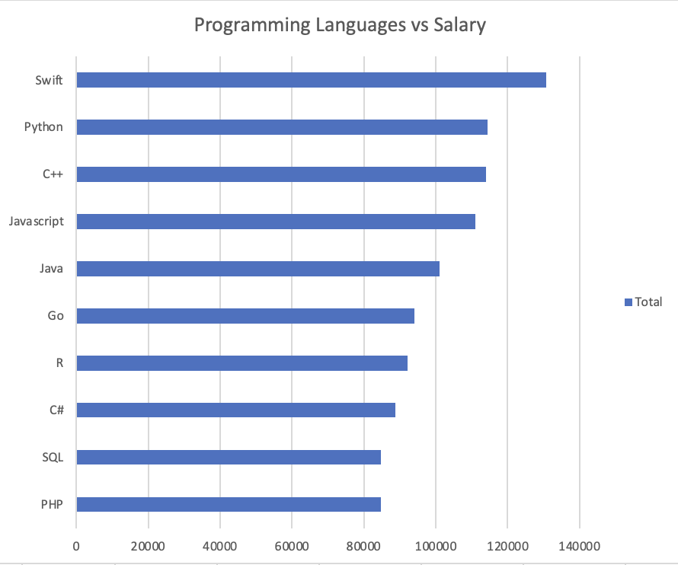
APPENDIX a: POPULAR LANGUAGES

